Slide 1
Understanding The Shifts
Mathematics Curriculum
Curriculum 2.0

Slide 2
The SHIFT
There are three major shifts happening in
your child’s math education
Curriculum
Classroom Environment
Assessment

Slide 3
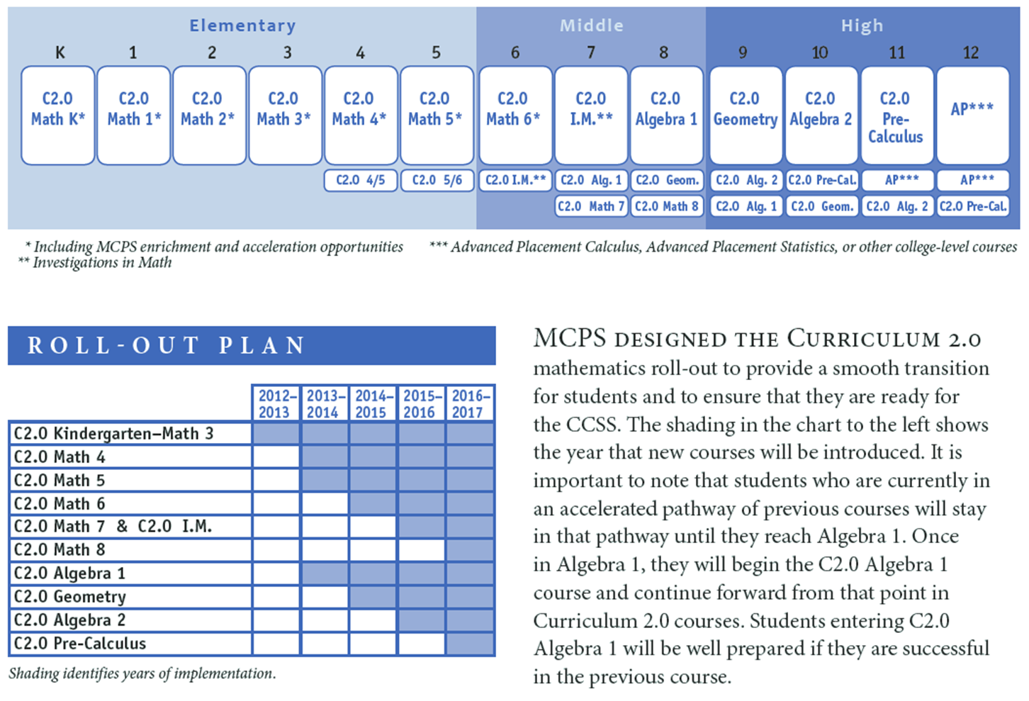
Timeline for these shifts (in curriculum)
2013-2014 → Algebra I
2014-2015 → Math 6 and Geometry
2015-2016 → Math 7 (and IM 2.0) and Algebra 2
2016-2017 → Pre-Calculus
The discussion for Honors courses are still going on

Slide 4
Curriculum
Common Core (CCSS) vs. Curriculum 2.0
CCSS are the Common Core State Standards adopted by the State of Maryland
Curriculum 2.0 is designed by MCPS
http://www.montgomeryschoolsmd.org/curriculum/math/
Notice and Wonder

Slide 5
Curriculum
Traditional
Common Core
More emphasis on procedure and a focus on the final result
Emphasis on conceptual learning and being able to solve problems
More show-and-tell method of teaching with
Less show-and-tell method of teaching and more student generated discoveries and ideas
Small concepts and ideas pieced together to create a “Unit”
“Big Picture” or Problem presented to students and allow students to discover given and missing information
Each Unit/Topic/Lesson is VERY rich in resources and explicit in helping teachers make lessons engaging for students

Slide 6
Classroom Environment
More collaborative environment among students working in small groups
Creating more critical thinking opportunities for students
Less show-and-tell then practice
Teacher is more of the facilitator and prompting questions for students to think to solve problems
Encouraging students to try, as well as explain their thinking and if they fail, try again!

Slide 7
Classroom Environment
Standards for Mathematical Practice:
Make sense of the problems and persevere in solving them
Reason abstractly and quantitatively
Construct viable argument and critique the reasoning of others
Model with Mathematics
Use appropriate tools strategically
Attend to precision
Look for and make use of structure
Look for and express regularity in repeated reasoning

Slide 8
assessments
HSA for Algebra 1 will still occur in 2013-2014 school year but we will already teach Curriculum 2.0
PARCC assessments will roll out in the 2014-2015 to replace MSAs and HSAs
(PARCC – Partners for Assessment of Readiness for College and Careers)
Less multiple choice
Entirely online
More focus on
Literacy Skills
Analyzing Data
Identifying a Problem
Thinking critically to solve problems
MAP-M (Grades 3 – 8)
(MAP-M – Measures of Academic Progress)
To help guide instruction—not for achievement or evaluative purposes

Slide 9
How do I support my child at home?
Please understand that the emphasis is no longer on the procedure of the math. It’s about the thinking. Students should be thinking, “HOW do I get the answer?”
Support the possibility that your child may follow different paths to answering a math problem and that they may solve a problem differently than how you may solve it.
Don’t rush in with the answer. Discourage the idea that their way of solving the problem is wrong. Allow them time to explore different ways to solve problems.
Question your child by asking:
“How did you come to this answer?”
“What was the lesson about today?”
“What were you trying to figure out?”
“How did you know?”

Slide 10
Resources???
Currently, MCPS has not adopted a textbook for Algebra C2.0 at this time…
HOWEVER…
Students are encouraged to use the textbook as a reference to support concepts covered.
And…
http://www.illustrativemathematics.org/standards/hs
http://www.parcconline.org/samples/mathematics/high-school-mathematics
http://www.corestandards.org
http://mathforum.org/math_help_landing.html
http://www.khanacademy.org/
http://www.illustrativemathematics.org/
http://learnzillion.com/
http://www.smarterbalanced.org/

Slide 11
Questions???

