Slide 1
7th/ 8th Grade NEC Parent Presentation
Mrs. Lyons and Mrs. Chavis

Slide 2
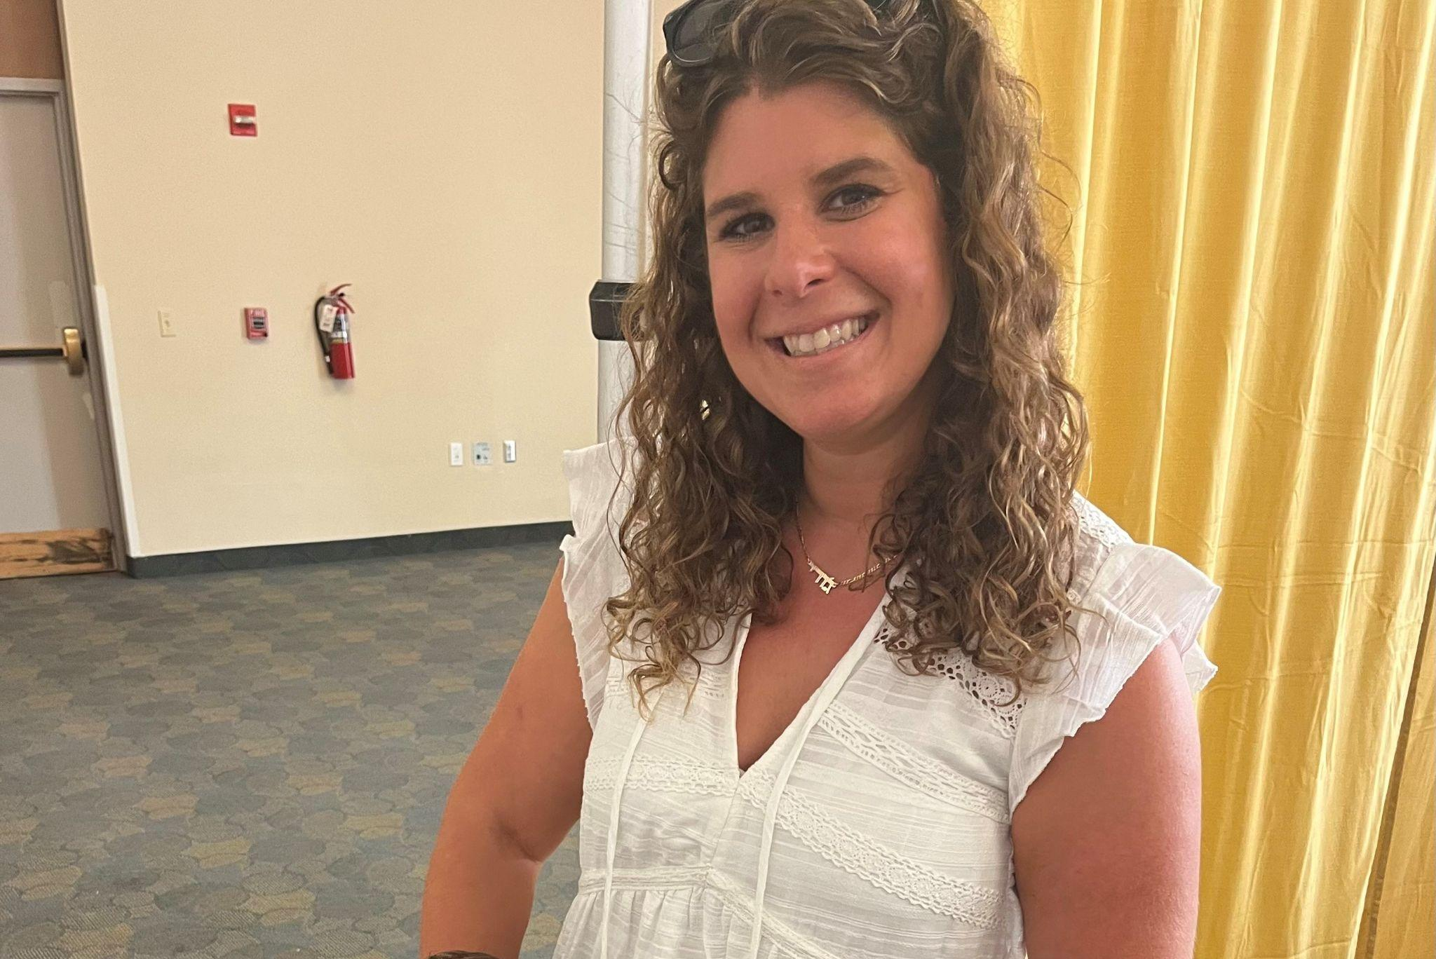
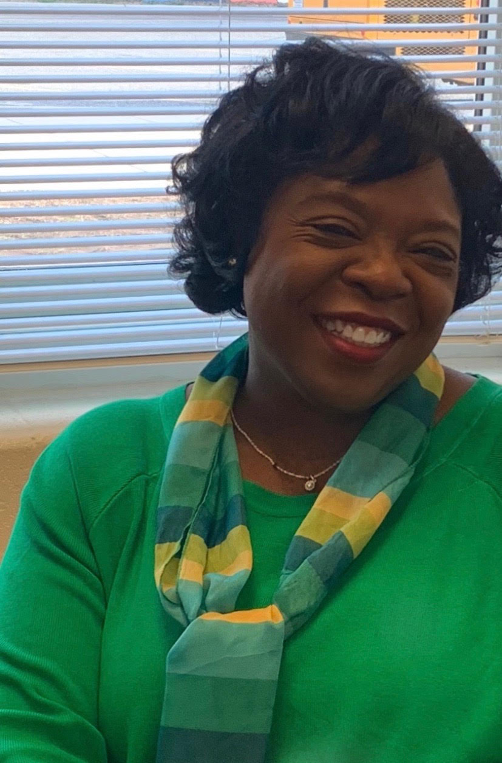
Counseling Department
6th Grade- Mrs. Williams
7th Grade- Mrs. Olowakakoko
8th Grade- Mrs. Lyons/Mrs. Chavis
Resource/ESOL/RELL/ALT- Mrs. McCoy-Snead
Secretary- Mrs. Perez

Slide 3
What is the NEC?
Acronym for Northeast Consortium
Students who reside in the NEC participate in a lottery choice process to be assigned to a high school
The High Schools in the NEC include: Blake, Paint Branch, and Springbrook
Each high school has a unique Signature program
Notes:
Review and define the NEC

Slide 4
Blake, Paint Branch, and Springbrook
NEC High Schools:

Slide 5
By November 3, 2023, you should submit a high school choice form ranking your preference of high school in the NEC (Northeast Consortium):
Blake High School
Paint Branch High School
Springbrook High School

Slide 6
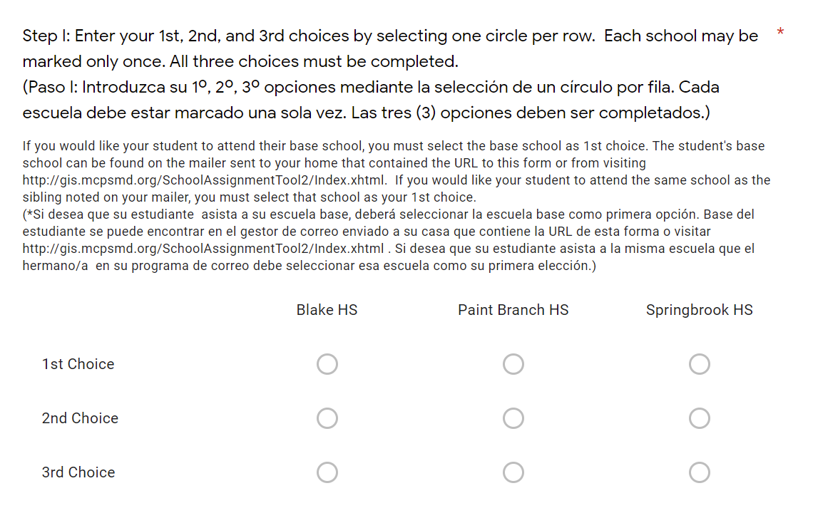
What is the lottery choice process?
Students submit their preference of high school on an electronic choice form
The choice form is run through a lottery to determine which high school is assigned
The choice process considers the following factors: Base school, rank order of preference, sibling link, enrollment capacity
Notes:
Share screen shot of what form looks like, let them know they will get the link to the form in October.

Slide 7
Student’s home address
Your base hs will be printed on the instructions letter you receive from the NEC office
To find your base, enter your home address into the assignment locator tool - Montgomery County Public Schools “School Assignment Tool”
What determines a student’s base high school?

Slide 8
Appeal to students’ interests and meet others with similar interests
Provide multiple courses in an area of interest
Provide experiences that relate to career interests
It sometimes helps you figure out what you don’t like; it does NOT track you into a particular career
All NEC high schools have a unique signature program
The NEC Signature programs are designed to...

Slide 9
Students who attend NEC middle schools but live outside of the NEC
Students that did not get their first choice during Round 1 can resubmit;
Choices cannot be changed after round 1 submission
You can only resubmit your original choices
Round 2 choice forms and resubmit forms are due on Feb. 9
Who can participate in Round 2 of the choice process?

Slide 10
Application Programs Open to NEC Students
Regional International Baccalaureate Diploma Program (Springbrook HS)
Montgomery College Middle College (Northwood HS)
Science, Mathematics, and Computer Science Magnet (Blair HS)
Wheaton/Edison Regional Programs
International Baccalaureate Career-Related Programs (IB/CP) at Rockville HS
Special Programs Open to ALL MCPS Students
Global Ecology House (Poolesville HS)
International Baccalaureate Diploma Programme (Richard Montgomery HS)
Visual Arts Center Einstein HS)
Notes:
(OPTIONAL) Parents must have and active Parentvue account to apply to the application programs Deadline is Friday November 3, 2023

Slide 11
Oct. 11 @ Blake 6:30pm
Oct. 18 @ Paint Branch 6:30pm
Oct. 25 @ Springbrook 6:30pm
NEC OPEN HOUSES

Slide 12
NEC School videos
https://www.youtube.com/watch?v=dNjX5gPVpSY
Notes:
3:27-1301

Slide 13
Questions/Comments/Concerns

