Slide 1
Financial Aid

Slide 2
What is Financial Aid?
Financial aid consists of funds provided to students and families to help pay for postsecondary educational expenses.

Slide 3
Sources of Financial Aid
Federal Government
Employers
States
Private Sources
College and Universities

Slide 4
How to Apply for Financial Assistance

Slide 5
FSA ID
An FSA ID gives you access to Federal Student Aid’s online systems and serve as your legal signature.
Both the student AND a parent need to create one.
Will be used throughout the aid process, including subsequent years.
https://fsaid.ed.gov

Slide 6
Free Application for Federal Student Aid (FAFSA)
MUST be filled to receive federal aid
Required for some state and institutional as well
A standard federal form that collects demographic and financial information about student and family
May be filed at any time during an academic year, but no earlier than the October 1st prior to the academic year for which the student requests aid

Slide 7
Ways to file the FAFSA
FAFSA on the Web (FOTW)
myFAFSA via myStudentAid mobile app
Paper (PDF) FAFSA
FAA Access to CPS Online
FAFSA on the Phone (FOTP)

Slide 8
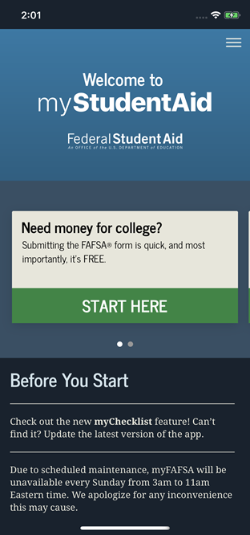
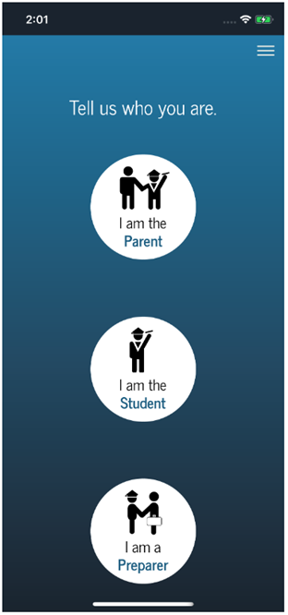
FAFSA can now be completed on an app!

Slide 9
FAFSA: Prior-Prior Year
Starting October 1, 2020, students can begin FAFSA for 2021-22 academic year using prior year info.
2019 Tax Info

Slide 10
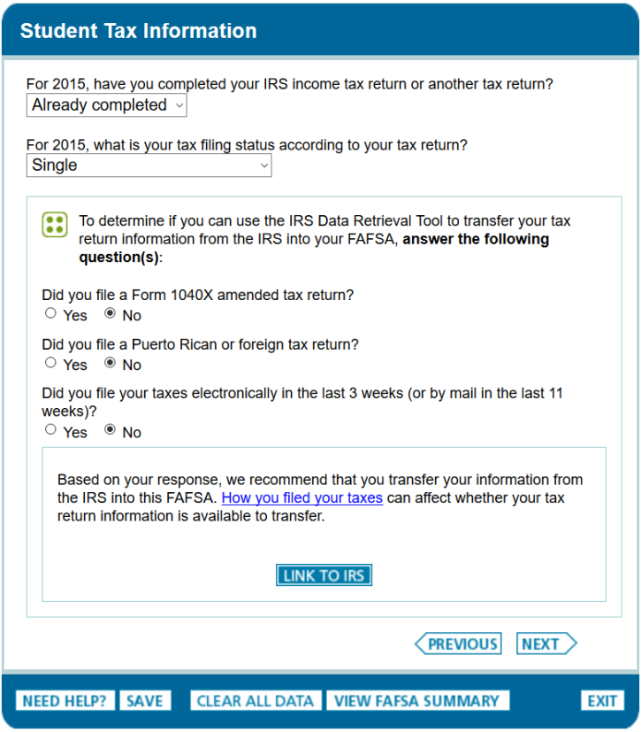
IRS Data Retrieval Tool (IRS DRT)
The IRS Data Retrieval Tool allows students and parents to access the IRS tax return information.
Transfer the data directly into their FAFSA from the IRS Web site.

Slide 11
Who’s data is entered?
Student
Demographic
Income if earned
Parent
All parents in the household

Slide 12
How is all of this information used?

Slide 13
What is the Expected Family Contribution (EFC)?
Calculated by formula in FAFSA
Stays the same regardless of college
Amount a family can reasonably be expected to contribute per academic year of education

Slide 14
High Impact Information & EFC
Tax Info
AGI, Taxes, Earnings
Current Financial Info
Cash/Savings, Investments, Business/Farm income
Number in Household
Number in College
Untaxed Income

Slide 15
CSS Profile
CollegeBoard Financial reporting
Used to determine need for institutional aid
Uses 2 years of financial data
Includes private assets in EFC calculation
Fee for initial application and one college report is $25.
Additional reports are $16.
Used by approx. 400 colleges and scholarship programs
Only 3 in MD
Notes:
Hopkins University
Loyola University
St. Johns College

Slide 16
How do schools use this data?

Slide 17
What is Cost of Attendance (COA)?
Direct costs
Tuition
Fees
Room
Board
Indirect costs
Books
Transportation
Personal Expenses
Loan Fees
Cost of Attendance

Slide 18
What is Financial Need?
Cost of Attendance
Expected Family Contribution (EFC)
Financial Need

Slide 19
Categories of Aid
Need-based aid
Non-need-based aid

Slide 20
Types of Aid
Scholarships
Grants
Work-Study Employment
Loans
Self-Help Aid
Gift Aid

Slide 21
Main Sources of Aid

Slide 22
Institutional Funding
Scholarships
Awarded for student achievement regardless of financial need
Universities will have separate scholarship applications for the different colleges
Grants
Need based funds offered to assist in covering CoA

Slide 23
State Funding
An only be used for MD schools
Aid is awarded on the basis of both merit and need
FAFSA is required for some
March 1, 2021
For MD funding check Maryland Higher Education Commission (MHEC) www.mhec.state.md.us
Legislative Scholarships
www.mdelect.net

Slide 24
Outside Scholarships
Scholarship search engines
Fastweb
Scholarships.com
Cappex
Scholly
Niche
Scholarship Monkey
Scholarships are everywhere

Slide 25
Loans

Slide 26
Loan Types
Stafford Loans
Student Loans
Subsidized
Unsubsidized
PLUS Loans (Parent)
Private Source Loans
Banks
Credit Unions
Private Loan Servicer

Slide 27
Subsidized VS. Unsubsidized
Direct Subsidized Loans are available to undergraduate students with financial need.
Your school determines the amount you can borrow, and the amount may not exceed your financial need.
The U.S. Department of Education pays the interest on a Direct Subsidized Loan
while you’re in school at least half-time,
for the first six months after you leave school
during a period of deferment
Direct Unsubsidized Loans are available to undergraduate and graduate students.
Your school determines the amount you can borrow based on your cost of attendance.
You are responsible for paying the interest on a Direct Unsubsidized Loan during all periods.
If you choose not to pay the interest while you are in school and during grace periods, your interest will accrue and be capitalized

Slide 28
Loan fees change every year.
Example: 1.059%
$5500 loan fees= $58.25
Total amount credited to your account= $5441.75

Slide 29
Rates for 2021 and beyond will change annually.
Interest rates are fixed for the life of the loan.

Slide 30
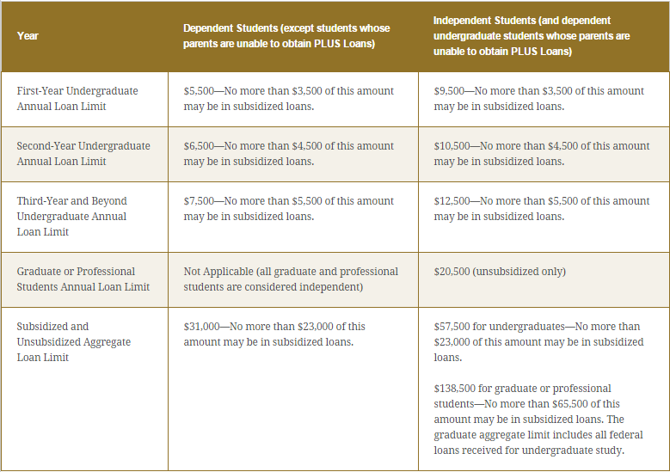

Slide 31
What else…

Slide 32
Special Circumstances
Conditions exist that cannot be documented with the FAFSA
Send written explanation and documentation to your college’s financial aid office
College will review and request additional information if necessary

Slide 33
Secondary school tuition
Unusual uncovered medical/dental expenses
Extraordinary dependent care
Parent or spouse death
Loss of employment
Divorce

Slide 34
Financial Aid Packages
Early Decision/Action Applicants
Regular Decision
Financial Aid Packages included in admit packet
Should include (if eligible)
Federal Grants
State Grants
Institutional Need Based Grants
Institutional Scholarships
Federal Loan options

Slide 35
Tools You Can use
Federal Student Aid
https://studentaid.gov
FAFSA4Caster
Help to get an idea of EFC/Need
“College Cost Worksheet”
Net Price Calculators (NPC)
Every Title IV school is required to have one

Slide 37
Questions? Contact Info: www.smcm.edu/osfa osfa@smcm.edu

