Slide 1
Introduction to Naviance Student View
All seniors should be registered!
Notes:
Naviance is a comprehensive college and career readiness solution for high schools that helps connect academic achievement to post-secondary goals.
Naviance Student provides one place for students to identify their strengths and align their interests to long-term college and career goals.
From the school side it has all the tools schools and district administrators need to monitor progress and track student outcomes.

Slide 2
Home Page

Slide 3
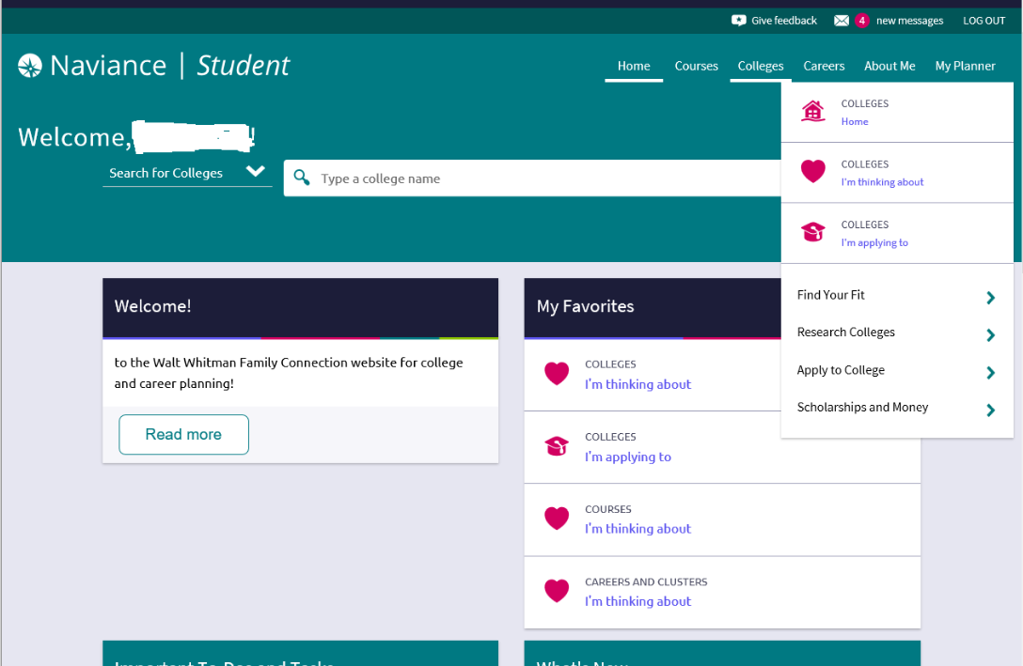
Colleges
Notes:
By going to the college tab students will find:
Find Your Fit- this is a place where students can do college searches based on his/her own criteria. and look at scattergrams.
Research Colleges– Add colleges to “Colleges I’m Thinking About”, compare colleges to one another, view and register for college visits.
Scholarship and Money – allows your student to research scholarships and deadlines

Slide 4
Find your fit

Slide 5
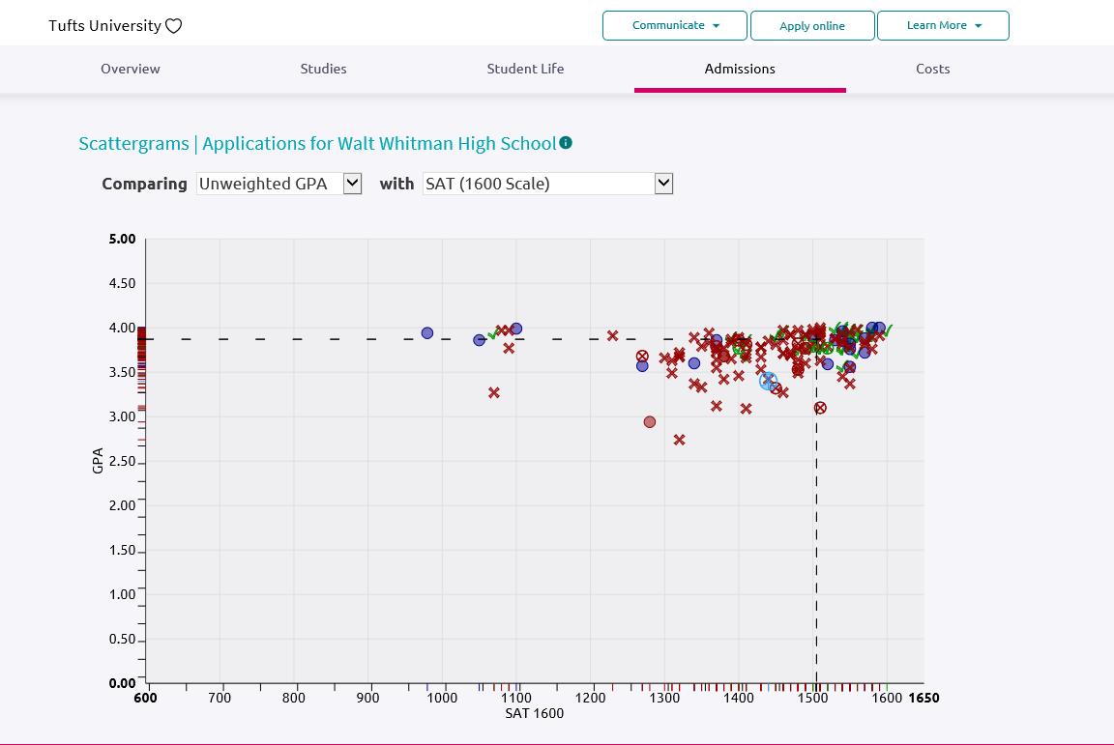
Scattergrams, “Reach” School
Notes:
These are examples of where “Walt Whitman,” who has a 3.65 GPA and 1490 SAT score, compares to previous students and whether they were accepted to these colleges. In this case, Walt should consider Northwestern Univ. more of a reach.

Slide 6
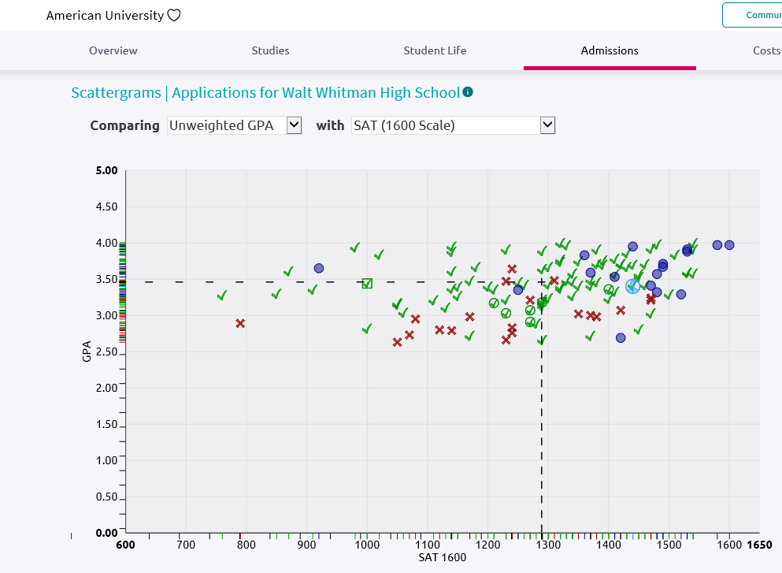
Scattergrams, “Likely” School
Notes:
In this case, Walt Whitman would use Penn State as a likely school with a high likelihood of acceptance.

Slide 7
Research Colleges

Slide 8
Colleges I’m Thinking About
Notes:
Colleges I’m thinking about allows students to:
List the schools they are interested in
At a glance determine the type of application the school uses. In this example, University of Michigan and Northwestern University use the common application. Univ. of Maryland has an electronic application and Eastman School of Music will require the application and/or the transcript to be mailed.
Quickly see Application Deadlines by clicking on the multiple deadlines drop down.
By clicking “More” you can go directly to the scattegrams and the college’s website.

Slide 9
Apply To Colleges
Notes:
?????????

Slide 10
Letters of Recommendation

Slide 11
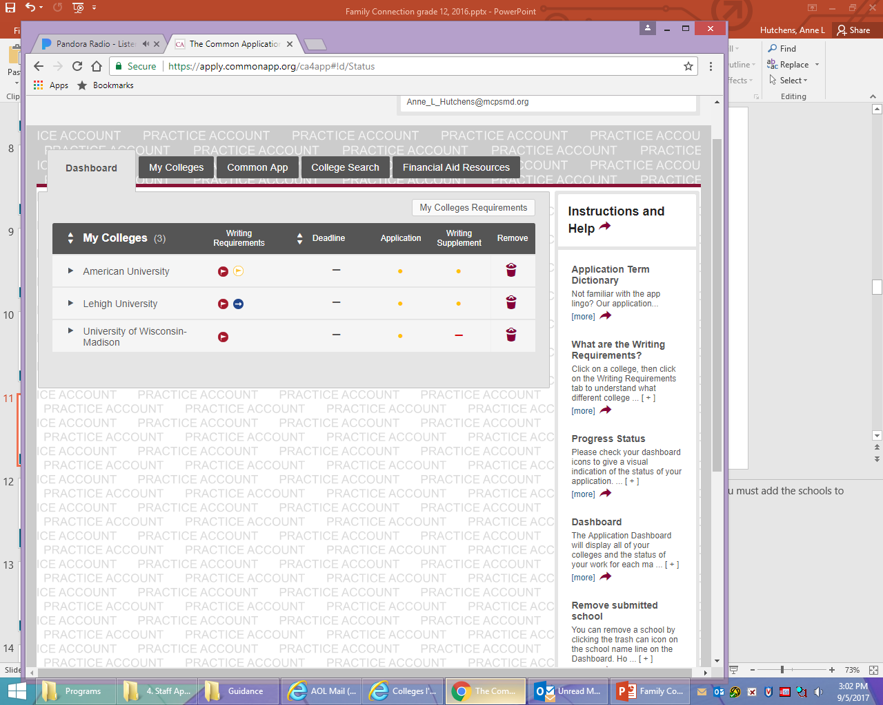
Common App Schools
Notes:
There is no connection between “Colleges I’m thinking about” in Naviance Student and colleges listed on your Common App. You must add the schools to which you wish to apply to your list in the Common App.

Slide 12
Common App Account Matching
You will need
Common App e-mail address, which should match the Naviance e-mail address
Student’s date of birth
Complete and submit the FERPA waiver (paper or online???)
Notes:
(??) Once your student is ready to apply to colleges, matching his/her Naviance account to the Common App is essential. Even if your child does not plan to apply to any common app schools, he/she must still create a common application account to sign the FERPA waiver.

Slide 13
Common App Account before matching
Notes:
After a student waives his/her FERPA rights, she logs into Naviance, goes to the Colleges I’m Applying To and “matches” the Common Application to the Naviance account. By doing this, Whitman is able to send documents electronically.

Slide 14
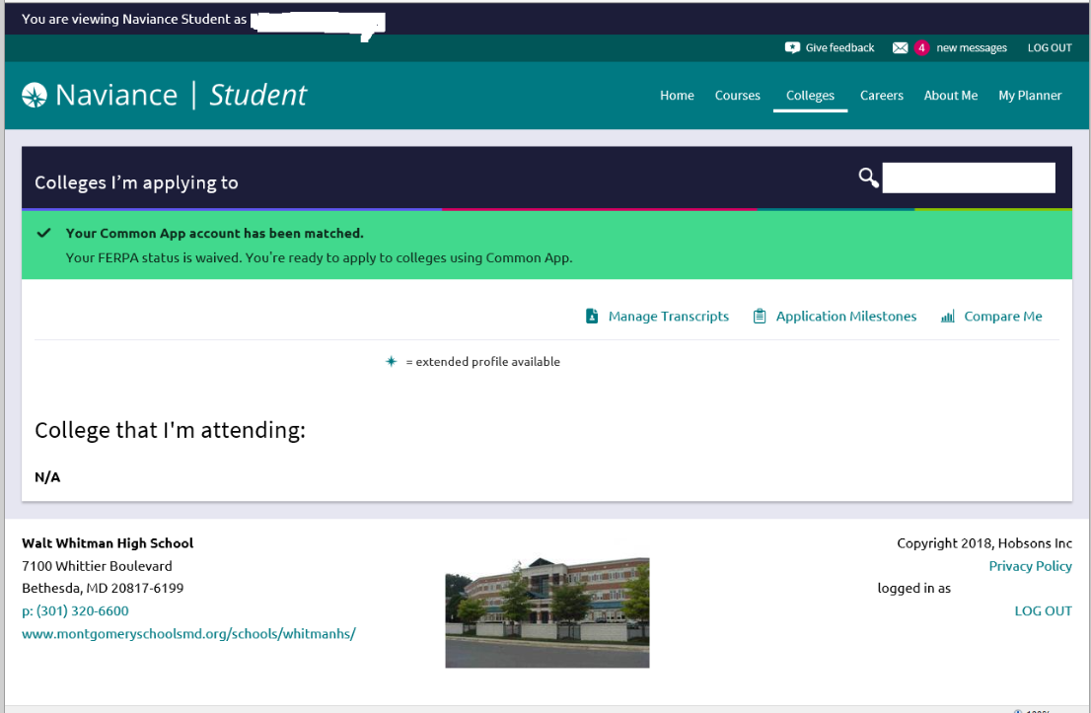
Common App Account after matching

Slide 15
FERPA Waiver - MUST be complete for us to send out your transcripts!
Notes:
FERPA, the Family Educational Rights and Privacy Act, is a Federal law that protects the privacy of student education records.
The first page is a FERPA Release Authorization explanation. It requires you to acknowledge reading and understanding the page before choosing continue.
The second page contains two areas – an authorization area and a waiver area:
Check “I authorize every school that I have …” This authorizes schools to release your student’s records and for admissions personnel to contact the school if needed.
Click “I waive my right …” It is generally believed that recommenders will be more forthcoming if a student waives his/her right to read the recommendations and reassures colleges that your student’s recommenders have provided support that is candid and truthful.
Check “I understand that my waiver or no waiver …”
Your student should sign and date the form before saving it. Note once you save the form you cannot change it.

Slide 16
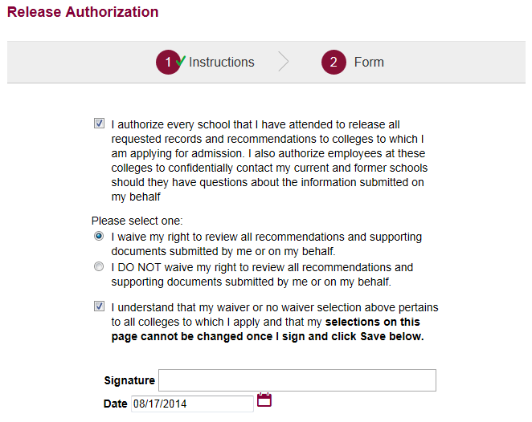
FERPA Waiver - MUST be complete for us to send out your transcripts!

Slide 17
FERPA Release - Rights Waived Example

Slide 18
Colleges I’m Applying To
Notes:
Seniors are not able to add schools to the “Colleges I’m Applying To”. As transcript requests are turned in, Whitman adds the colleges/universities to this list so that we can ensure documents are sent in a timely manner.

Slide 19
Procedures for Submitting Teacher Recommendations and Transcript Requests

Slide 20
Teacher Recommendations
Specify recommenders on transcript request form
Either the student, College Coordinator or Transcript Secretary are able to enter into the system.
Notes:
Your student should communicate with his/her recommender about the schools he/she is applying to.

Slide 21
Teacher Recommendation Cont’d.

Slide 22
Teacher Recommendations Cont’d.

Slide 23
Transcript Requests
Note the college application deadline
Submit requests three weeks prior to the deadline
Review “It’s Time Packet” with counselor at least 3 weeks prior to deadline
Note – the “It’s Time Packet” includes a parent reflection as well as a student reflection.
Submit requests four weeks prior to January 1 deadline
Hand directly to the Transcript Secretary Ms. Lobo, NOT UNDER HER DOOR!!!
Notes:
Requesting a transcript isn’t just a click of the button, other forms and paperwork must be filled out both by the student and by the school. Your student’s counselor will need to fill out a Secondary School Report and submit a recommendation of his/her own. It is imperative that you give staff ample time to complete your request. Remember there are over 500 seniors applying to multiple schools and over 9,000 transcripts are sent out yearly.

Slide 24
Transcript Deadlines
(listed in It’s Time packet!)
College Deadline
October 15
November 1
November 15
December 1
December 15
January 1
January 15
Due in Transcript Office
September 20
October 4*
October 25
November 9
November 20
December 4*
December 18*

Slide 25
Submitting to Transcript Office
Release Records Form - only once
Proof of FERPA waiver - only once
Transcript Request
Early Decision Form, if applicable
Notes:
The school needs appropriate consent to release your student’s records. One copy of this signed form must be on file in the transcript office. This form should be submitted with your student’s first transcript request.
The student’s fill out one request form per college applying to. If your student is applying to 7 schools, he/she will need to submit 7 transcript requests forms even if they are all common app schools.
The Early Decision form is a Common App form. It is only required if your student is applying early decision.

Slide 26
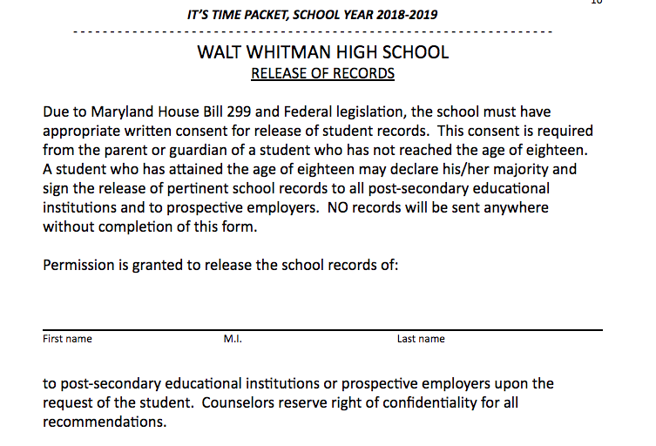
Release of Record Form: Example

Slide 27
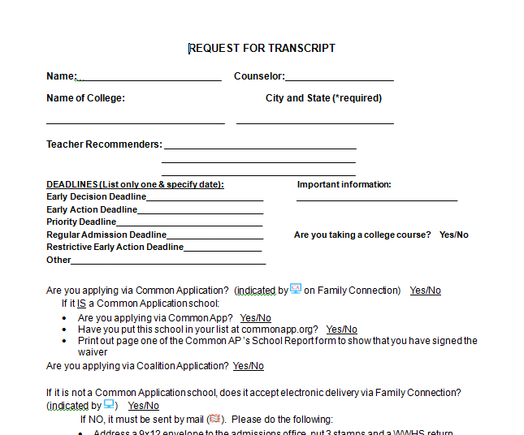
Transcript Request Form: Example
Notes:
Note this is where you specify who your Teacher Recommenders are so the CIC and Transcript personnel can enter it into the system, allowing teachers to file recommendations for all schools electronically.

Slide 28
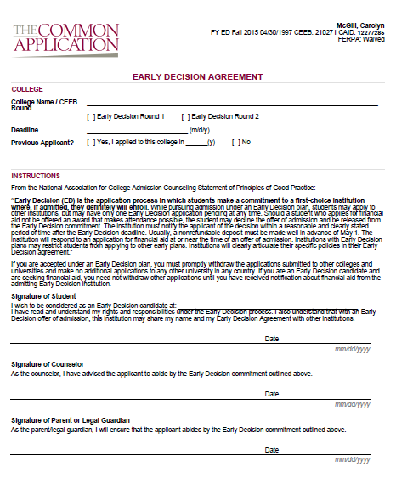
Common App Early Decision Agreement: Example
Notes:
If you are applying Early Decision, download the paper ED agreement and clip the agreement, signed by the student and a parent, to the transcript request form along with a stamped business sized envelope addressed to the admissions office. The student and parent will also need to sign the ED agreement online when the application is submitted.

Slide 29
Test Scores
The counseling office CANNOT send students’ test scores. The student must send the scores and ensure receipt.
Send test scores to colleges
SAT – www.collegeboard.org
ACT – www.act.org
Notes:
Whitman does not send test scores to schools. The student must go to the testing website and request scores be sent to the schools to which he/she is applying.
Students should carefully read standardized test requirements and policies for each university because they vary from university to university and sometimes even college to college within the same university (e.g., engineering v. liberal arts).

