Slide 1
Senior Parent Night
Sherwood High School Counseling Services
Notes:
Welcome
Reminder to please hold questions until breakout with counselors at the end of the presentation.

Slide 2
Tonight’s agenda
Excellence Is The Only Option
Mr. Harris– Welcome
PTSA
Counseling Department
Presentation
Break-out sessions with counselors
Achievement * Civility * Engagement *Unity* Integrity

Slide 3
Tonight you will:
Excellence Is The Only Option
Consider Next Steps
Gain Understanding of the College Application Process at Sherwood High School
Learn about Resources
Achievement * Civility * Engagement *Unity* Integrity

Slide 4
Options After High School
Excellence Is The Only Option
Apprenticeships (Trades)
Training Programs/Career Programs
Montgomery College, Lincoln Tech
Post-Secondary School
4 year College/University
Community College
Career Programs
Associates Degree
Certificates
Military
Volunteer/Gap Year
Work
Achievement * Civility * Engagement *Unity* Integrity

Slide 5
How Do I Start? Naviance
Excellence Is The Only Option
Resources: About Me/Careers/Colleges
Goal Setting
Resume Building
Four Year Course Plans
Personality Profile– connects careers and possible majors in college
Career Exploration
College Search
Customized data relating to SHS students
Supports college planning and the application process
Linked to colleges worldwide and their websites. https://student.naviance.com/Sherwood
Username: Student Email address.
Password: Student ID# (6 digit ID#).
Achievement * Civility * Engagement *Unity* Integrity

Slide 6
College Application Process
Excellence Is The Only Option
Select your colleges of choice.
In Naviance, list those colleges under “Colleges I’m Thinking About”.
Know your deadline dates.
If using the Common App, Complete the FERPA and match the account to Naviance.
Complete and submit applications to the colleges.
Meet with Counselor or Mr. Hock with your transcript request form for approval.
Achievement * Civility * Engagement *Unity* Integrity

Slide 7
College Application Process
Excellence Is The Only Option
Submit the approved transcript request from to the registrar’s office at least 15 SCHOOL DAYS before the college deadline. (Lunch, Before and After School only)
Request letters of recommendation through Naviance
Students should have already spoken to the teachers requesting the recommendations.
Achievement * Civility * Engagement *Unity* Integrity

Slide 8
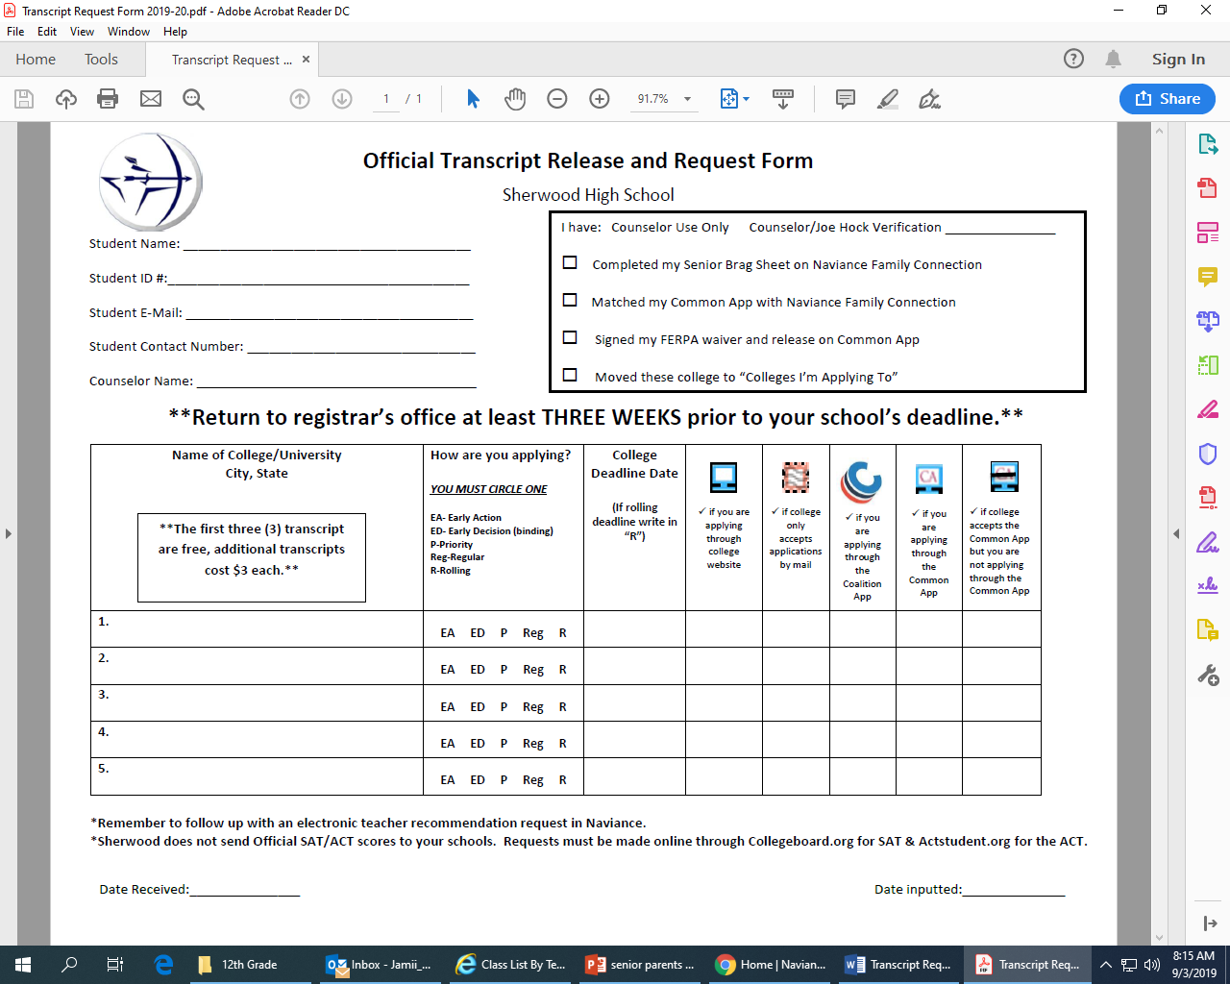
Excellence Is The Only Option
Achievement * Civility * Engagement *Unity* Integrity

Slide 9
College application Points to consider
Excellence Is The Only Option
Common Application - Complete the FERPA waiver on the Common Application website and connect the student’s Common Application to their Naviance account.
Be sure to use the same email address, exact name
Coalition Application – Check the boxes indicating that the high school will send grades and letters of recommendations separately.
Student must send SAT (www.collegeboard.org.) and/or ACT (www.actstudent.org) scores directly from test website(s) to colleges.
Achievement * Civility * Engagement *Unity* Integrity

Slide 10
Application Deadlines
Excellence Is The Only Option
College Deadline: | Student Deadline: Apply to the college; 2. Request Teacher Recommendations; 3. Turn in transcript request form to the registrar ON or BEFORE:
October 15 | September 24
November 1 | October 11
November 15 | October 25
December 1 | November 8
December 15 | November 22
January 1 | December 2
January 10 | December 6
January 15 | December 13
February 1 | January 10
February 15 | January 24
March 1 | February 7
Achievement * Civility * Engagement *Unity* Integrity

Slide 11
The Recommendation
Excellence Is The Only Option
Many colleges ask for letters of recommendation from:
Teacher(s) – request must be made in Naviance
Counselor
Teachers are responsible for submitting
their own letters of recommendation
by the deadline.
Achievement * Civility * Engagement *Unity* Integrity

Slide 12
SAT/ACT
Excellence Is The Only Option
SAT Date | Register By Date | Late Registion
October 5, 2019 | September 6, 2019 | September 17, 2019
November 2, 2019 | October 3, 2019 | October 15, 2019
December 7, 2019 | November 8, 2019 | November 19, 2019
ACT Date | Registration Deadline | (Late Fee Required)
October 26, 2019 | September 20, 2019 | October 4, 2019
December 14, 2019 | November 8, 2019 | November 22, 2019
* Free online tools available to help you prepare for taking the PSAT, SAT, or ACT. Use the study guides to learn more about the test, review specific skills, take practice quizzes, and track your progress.
Achievement * Civility * Engagement *Unity* Integrity

Slide 13
What is the ACCUPLACER?
Excellence Is The Only Option
The ACCUPLACER is a College Board placement test, NOT an entrance exam like the ACT or SAT.
The ACCUPLACER is used, not for admission to college, but to place students in appropriate course levels after admission.
Many colleges administer the ACCUPLACER to determine appropriate math and English placement if the admitted student does not have qualifying scores on the ACT or SAT.
Achievement * Civility * Engagement *Unity* Integrity

Slide 14
Financial Aid
Excellence Is The Only Option
Types of Financial Aid
Sources of Financial aid
Grants
Scholarships
Work Study
Loans
Federal Financial Aid (FAFSA) – can be in the form of grants or federal loans
State Financial Aid (MHEC- Maryland Higher Education Commission)
Institutional Financial Aid (from the college/university
Private Sources (independent scholarships and private loans)
Achievement * Civility * Engagement *Unity* Integrity

Slide 15
Financial Aid
FAFSA
All families should complete this application, as well as an MDCAPS account (State of MD)
Application is available beginning on October 1
Will use your 2018 Tax Return data
File by March 1 (if not earlier) to maximize aid
Financial Aid Parent Night
October 17, 2019 7:00pm SHS Cafeteria

Slide 16
Some College Visits Coming….
Excellence Is The Only Option
Colby College – 9/10 @ 1:00 PM
UMCP – 9/17 @ 8:40 AM
University of South Carolina – 9/17 @ 9:35 PM
Morgan State University– 9/17 @ 10:25 AM
University of Chicago – 9/17 @ 12:00 PM
University of Pittsburgh – 9/17 @ 12:50 PM
George Washington University – 9/18 @ 8:40 AM
Stony Brook University – 9/18 @ 10:25 AM
Catholic University – 9/18 @ 12:00 PM
Miami University, Oxford – 9/18 @ 12:50 PM
James Madison University – 9/19 @ 8:40 AM
University of Georgia – 9/19 @ 9:35 AM
Christopher Newport University – 9/19 @ 10:25 AM
Achievement * Civility * Engagement *Unity* Integrity

Slide 17
Follow the Counseling Cepartment on Twitter
Excellence Is The Only Option
@SHS_Counseling_
College visits
Pertinent info regarding the application process
Counseling and educational articles and information
Achievement * Civility * Engagement *Unity* Integrity

Slide 18
Questions and Answers
Excellence Is The Only Option
Achievement * Civility * Engagement *Unity* Integrity

Slide 19
Counselor Assignments
Excellence Is The Only Option
Giffen A - Ba Room H141
Carter Be - Da Room H136
Bray De – Gri Ertzman
Singleton Gro – Ke Room H139
Newbill Kh – Meh Ertzman
Thompson Mej – Pra Room H139
Sartori Pro – Sta Room H141
Avery Ste – Z Room H136
Achievement * Civility * Engagement *Unity* Integrity

