Slide 1
PHS
CLASS of 2025
Course Selection for 9th grade

Slide 2
Who is your child’s counselor?
Mr. Greg Hand, A-Diz greg_hand@mcpsmd.org
Mrs. Melissa Nagy Dj-Kil melissa_m_nagy@mcpsmd.org
Mrs. Barbara Martin Kim-Md barbara_j_martin@mcpsmd.org
Mr. Ramon Snow Me-Shez ramon_n_snow@mcpsmd.org
Ms. Nelly Boishin Shi-Z nelly.boishin@mcpsmd.net

Slide 3
Maryland Graduation Requirements
Course/Program | Number of Credits
English | 4
Science (1 physical sci. and 1 biology) | 3
Math (1 algebra and 1 geometry) mandatory each year of high school | 4
Social Studies (USH, NSL, MWH) | 3
Fine Art | 1
Physical Education | 1
Technology | 1
Health | 0.5
Program Completion Requirement: Foreign Language or Advanced Technology or Career Development | 2 2 4
Student Service Learning Hours | 75 Hours
Maryland High School Assessments

Slide 4
When making course selections for next year
Choose 7 courses for each semester
List alternative courses in the elective areas in the event of a master schedule conflict.

Slide 5
Course List

Slide 6
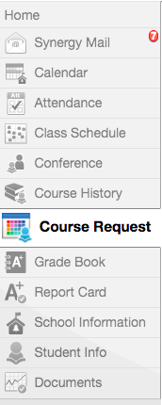
Student VUE

Slide 7
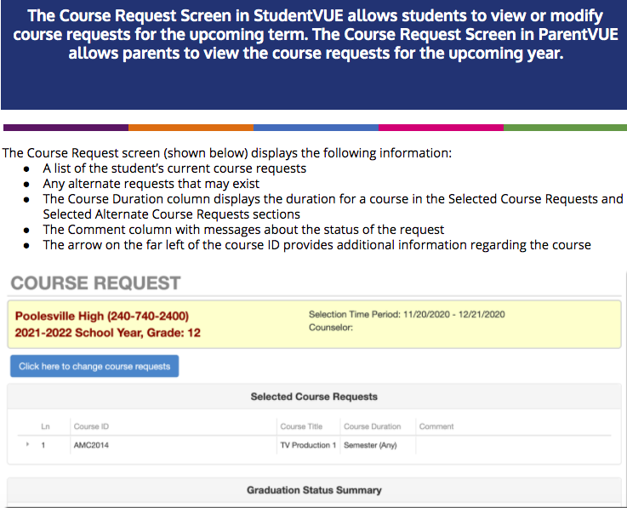

Slide 8
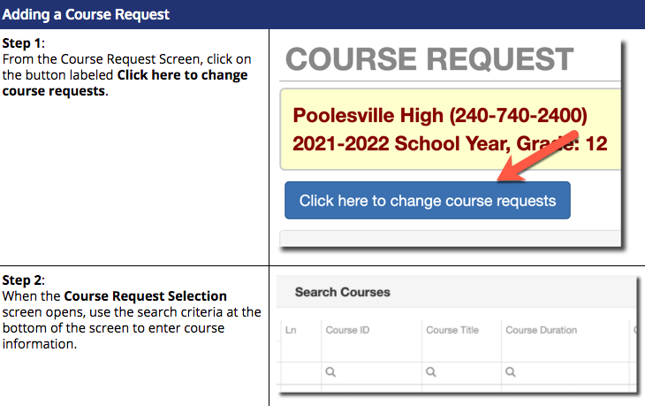

Slide 9
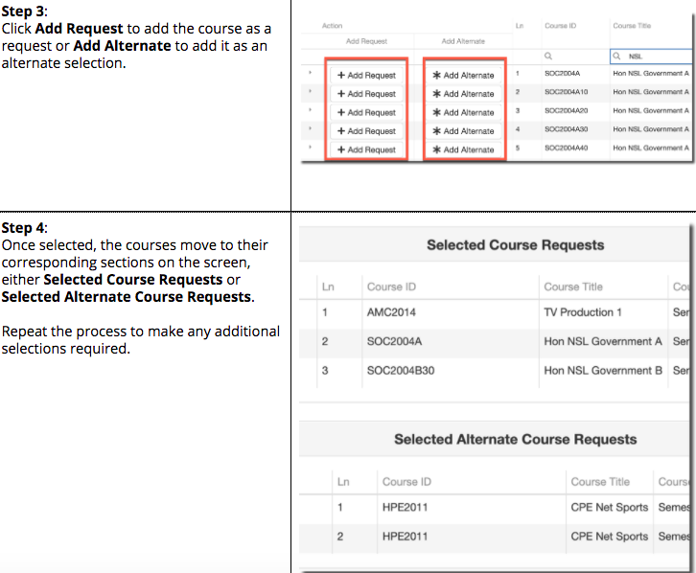

Slide 10
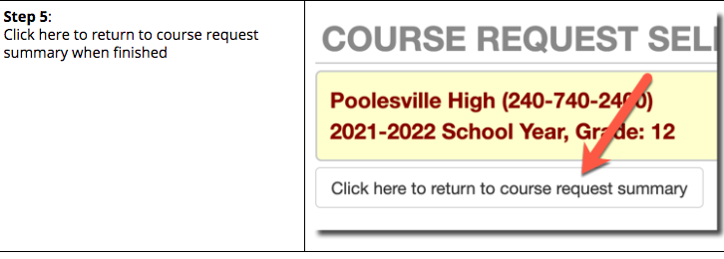

Slide 11
Course Requests: Helpful Hints
Do not hit enter. If you hit enter too many times your course requests will be locked and someone from school will need to unlock them.
If Chrome does not work, try using Microsoft Edge or another web browser.
You can also try putting requests in using your phone.

Slide 12
Course Requests
Course requests must be complete by 02/12/2021.
If your child is accepted into a magnet program, his/her course requests will be adjusted.
Please reach out to your child’s counselor if you have any questions.

