Slide 1
PBHS Junior Parent Information Night
Class of 2021

Slide 2
Agenda
Welcome
Senior Year and Beyond/Grad. Requirements
College/Career Center Resources
Naviance
Introduction to the College Application Process
Junior College Fair

Slide 3
GRADUATION REQUIREMENTS
Students are required to earn a minimum of 22 credits in order to earn a high school diploma from Montgomery County. The following credits are required for graduation:
4.0 English
4.0 Math (Algebra 1 and Geometry)
3.0 Social Studies (World History, NSL Gov’t, and US)
3.0 Science (1 Physical Science and Biology)
1.0 Technology
1.0 Fine Art
1.0 Physical Education
0.5 Health Education
2.5 Elective
The additional credits required for graduation may be fulfilled by one of the following options.
World Language (2.0)
Career Development Program (3.0 – 9.0)

Slide 4
Additional graduation requirements
Student Service Learning Hours (SSL)
Students must earn 75 hours of community service. You can find information on the MCPS website regarding approved community service opportunities for students. http://www.montgomeryserves.org/volunteers/student-service-learning-ssl
Maryland State Assessments
For up-to-date information visit http://www.montgomeryschoolsmd.org/curriculum/hsa/

Slide 5
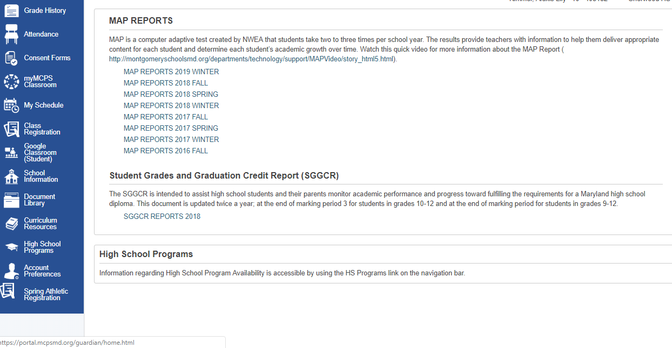
MCPS Parent Portal
Access transcripts
Click Document Library
Click on SGGCR Reports

Slide 6
Senior Course Selection
As your child selects his/her courses and electives, consider the following:
Remaining graduation requirements
College admissions prerequisites
Courses related to future career or intended college major

Slide 7
Enhancing Senior Year
Internship
World Language
Thomas Edison School of Technology
Dual Enrollment at Montgomery College
Child Care and Development
Restaurant Management
Academy of Finance
Broadcast Media (TV or Radio)
Extracurricular Activities(Sports, clubs, volunteer work)

Slide 8
Goal Setting
4- year college
2- year college
Technical School
Apprenticeship
Military
Work

Slide 9
College/Career Center Supports
SAT/ACT/Accuplacer
College Majors, Essays, and Applications
Financial Aid and Scholarships
College Representatives and Guest Speakers
Naviance
Resume Writing
Career Planning
College Selection

Slide 10
Naviance
Naviance is a FREE comprehensive online program that assists students and parents with:
College Search and Comparison
Career Exploration
College Application Process
Scholarship Searches

Slide 11
How do I access Naviance?
Website:
https://student.naviance.com/paintbranch
What if you forget your password?
Username: Email address
Password: Your child’s counselor/CCIC can reset password

Slide 12
Naviance Log-in:

Slide 13
Naviance Register:
See your student’s counselor for a
registration code.

Slide 14
College Admissions Components
College Application
Official Transcript
Testing: SAT, ACT, TOEFL
Letters of Recommendation
Financial Aid
Please be sure to attend a Senior Meeting this summer for more detailed information.

Slide 15
What should I be doing now?
Register for the SAT / ACT
Begin researching postsecondary options
Consider teachers for letters of recommendation
Resume / Brag Sheet
Schedule college tours

Slide 16
How do I register my child for a college admissions test?
SAT
www.collegeboard.org
Test Date: May 2nd ; Register by April 3rd
Test Date: June 6th ; Register by May 8th
ACT
www.act.org
Test Date: June 13th; Register by May 8th
Test Date: July 18th; Register by June 19th
http://www.montgomeryschoolsmd.org/schools/paintbranchhs

Slide 17
PBHS SAT SCHOOL DAY
March 25, 2020

Slide 18
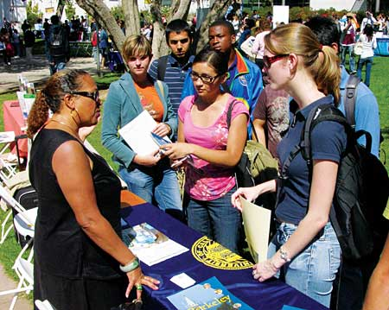
Junior College Fair
Where: Discovery Sports Center 18031 Central Park Circle Boyds, MD 20841
When: April 1st during the school day
How: By March 27th submit
$7.00 & signed permission
slip to Mrs. Kelly in the
College/Career Center.
Parents may attend the
evening of March 31st
from 6:30-8:30 for FREE.

Slide 19
For Junior College Fair Participants visit:
https://hub.nacacnet.org/CollegeFairDirectory?id=a0k1P000017XRJ7QAO&_ga=2.252955791.760111320.1580135925-972041635.1576775955

Slide 20
Questions?
Please call
301-388-9920
with any additional questions.

