Slide 1
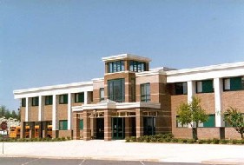
Colonel Zadok Magruder High School
Colonels’ Local Summer School Program 2020
Dr. Leroy C. Evans, Principal
Mr. Clark Montgomery, Assistant Principal, and Summer School Coordinator
Notes:
Cover Page:
Dr. Leroy C. Evans, Principal
Mr. Clark Montgomery, Assistant Principal and Summer School Coordinator

Slide 2
The vision of Colonel Zadok Magruder High School’s Local Summer School Program is to afford our students, like other MCPS students, an opportunity to participate in summer academics and enrichment programs through a virtual learning experience.
Notes:
Vision of Colonel Zadok Magruder Local Summer School Program

Slide 3
Audience
Colonel Zadok Magruder High School’s local summer school program is intended to serve the needs of our incoming and current 9-12 students who want to take an original credit course, a Math Boost course for non credit, a high school credit recovery course, or a summer enrichment course. It is designed to meet the needs of Magruder families. Please note that offerings are based on student enrollment, which is gathered through registration, counselor referrals, and family referrals. Enrollment is prioritized using student data and the need to meet graduation requirements. Enrichment program offerings are also included to engage students in fun and engaging activities.

Slide 4
The Virtual Learning Experience
The summer virtual learning experience will be different from Marking Period 4 during the Continuity of Learning.
Teachers will be providing synchronous instruction.
Student engagement will occur through class discussions, small group interactions, live instruction, and other innovative methods and instructional strategies using instructional technology.
Notes:
Virtual learning experience

Slide 5
Summer Offerings
Math Boost - Non-credit
High School Original Credit for Selected Courses
High School Credit Recovery
Summer Enrichment (LSP)
Summer Enrichment in Partnership with George B. Thomas, Sr. Learning Academy Online (SAT Prep)
Notes:
Local Summer School Program Offerings:
High School Original Credit for Selected Courses
High School Credit Recovery
Summer Enrichment (LSP)
Summer Enrichment in Partnership with George B. Thomas, Sr. Saturday School Summer Program

Slide 6
Math Boost

Slide 7
MATH BOOST
High School Mathematics Boost is a non-credit program that will address learning recovery in mathematics to help students prepare for next math course:
Algebra 1
Geometry
Algebra II
Pre Calculus
Notes:
Math Boost - Noncredit

Slide 8
High School Credit Recovery/ Original Credit
REPEAT COURSES/ORIGINAL CREDIT
Online courses in all core academic areas traditionally offered in summer school
Repeat courses for students who need to repeat a course to remain on track for graduation
For original credit (i.e. Health) or to raise a grade
Full courses like summer school, all online with synchronous instruction
July 13-August 14
Free for repeat courses, fees Magruder High for original credit or to raise a grade.

Slide 9
High School Original Credit
Magruder High
Local Summer School Payment for High School Original Credit or to raise a Grade
Notes:
High School Original Credit will be offered for selected courses like Health/Foundations of Art.

Slide 10
Original Credit
COURSES MAY BE TAKEN FOR ORIGINAL CREDIT
Online courses in all core academic areas traditionally offered in summer school
For original credit (i.e. Health) or to raise a grade
Full courses like summer school, all online with synchronous instruction
July 13-August 14
Fees $150.00 ($75.00 discounted fee for original credit, complete partial tuition waiver form 325.5lsp)
Make your online Local Summer School Payment for Original Credit Courses here: Magruder High.

Slide 11
High School Credit Recovery
Notes:
Teachers have written proposals for summer enrichment activities. Offerings will be contingent upon student enrollment.

Slide 12
Repeat Courses
Online courses in all core academic areas traditionally offered in summer school
Repeat courses for students who need to repeat a course to remain on track for graduation
Free for repeat courses

Slide 13
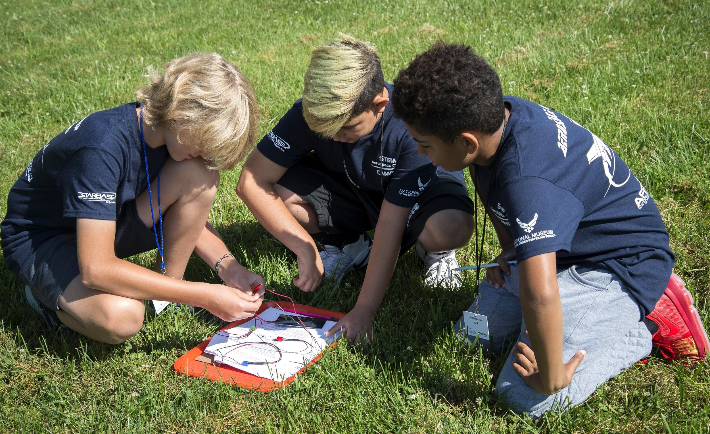
Summer Enrichment and
“Camp” Programs
ENRICHMENT “CAMPS” AND PROGRAMS
Three weeks between July 13 - August 7
Notes:
Teachers have written proposals for summer enrichment activities. Offerings will be contingent upon student enrollment.

Slide 14
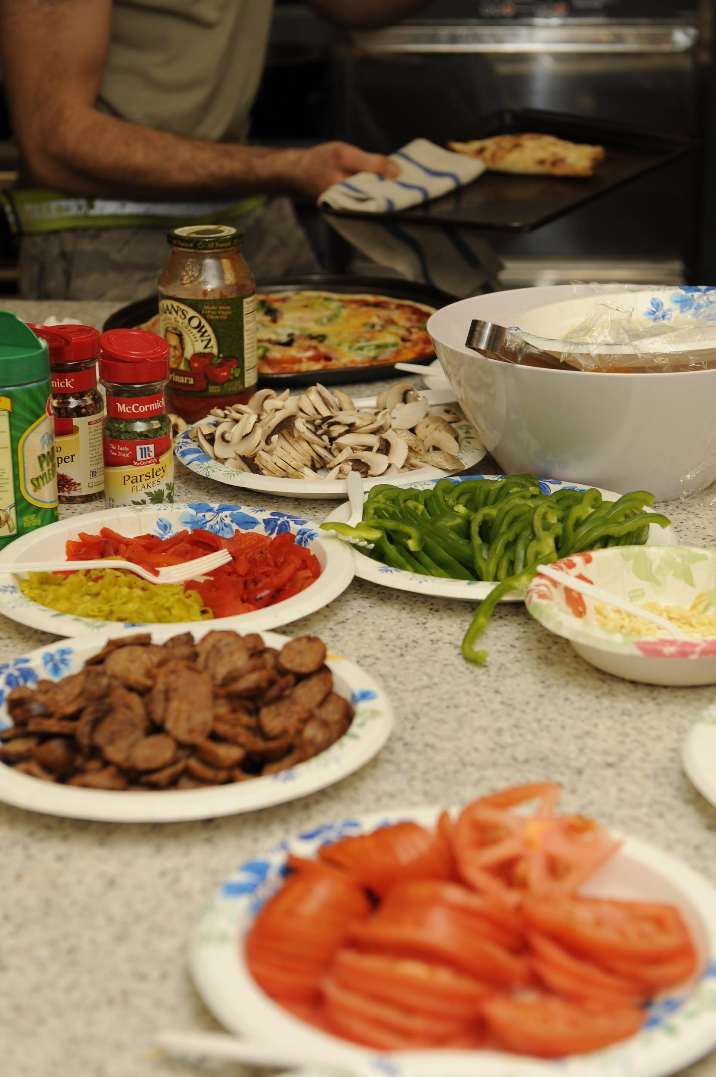
Nutrition, Food Safety, and Cooking Techniques
Enrichment Program Title: Nutrition, Food Safety, and Cooking Techniques
Length of Program: Three Weeks
Lesson Length: 50 Minutes
Grade Levels: Incoming High School (9-12)
Proposal Idea: Students will be taught nutrition, meal planning, food safety (including food borne illness and kitchen safety), cooking techniques, tools, recipe development. Lessons will also include current events including the present coronavirus pandemic and the role of food in staying healthy.
Notes:
Nutrition, Food Safety, and Cooking Techniques

Slide 15
Creative Journaling
Enrichment Program Title: Creative Journaling
Length of Program: Three Weeks
Lesson Length: 50-100 min
Grade Levels: High School (9-12)
Proposal Idea: Students will be able to construct a creative journal to use in their everyday lives. This will include calendar/agenda building, daily and life trackers, written journal responses, and art prompts. Creative journaling is a great way to stay organized and express yourself. Students would need a journal, pen/pencil, coloring utensils of their choice. This is a great way to incorporate arts integration!

Slide 16
Yoga, Fitness, and Mindfulness
Enrichment Program Title: Yoga, Fitness, and Mindfulness
Length of Program: Three Weeks
Lesson Length: 50 minutes
Grade Levels: High School (9-12)
Proposal Idea: This enrichment activity will consist of yoga poses, fitness components as well mindfulness practices and yoga poses and the purpose of all the beginning poses. Mental health practices, meditation practice and overall health and wellness. Leading daily activities through the use of google classroom meets and use zoom. Fitness classwork activities as well as journaling and meditation practices. There would be weekly assessments checking for understanding.

Slide 17
PARTNERSHIP
Colonel Zadok Magruder High School has a partnership with George B. Thomas, Sr. Through the partnership, families might access program such as: Robotics, Coding, and SAT Prep.
Notes:
Partnership

Slide 18
MHS Local Programs and Courses
Click on the link below to see a list of all programs and courses. These include but are not limited to: core academic subjects and summer enrichment activities.
Colonels' Summer Course Offerings at Magruder

Slide 19
Student Attendance
Student attendance is required and will be taken daily.
Students are required to engage in the virtual learning experience and meet the expectations and requirements of the course
Teachers will clearly communicate attendance and participation expectations to the students.
Each teacher will share the platform for engagement.

Slide 20
Special Education
Students receiving special education services should continue receiving the accommodations outlined on their IEP.

Slide 21
Platforms
Google Classroom
myMCPS Classroom (Canvas)
APEX

Slide 22
Schedule
Classes will be offered three days a week. (Tuesday, Wednesday, and Thursday)
Classes will run July 13 - August 14.
Selected summer enrichment classes will be three weeks (July 13 - August 7).
A student may register up to three classes.
Classes will be 50 minutes.
Students and teachers will meet through Zoom.

Slide 23
Schedule
Session | Time
1 | 1:00 p.m. - 1:50 p.m.
2 | 2:00 p.m. - 2:00 p.m.
3 | 3:00 p.m. - 3:50 p.m.
Teachers will share Zoom meeting ID and passwords with students.
Times are subject to change based on enrollment.

Slide 24
To register for summer programs/courses, please click on Register to access the form:
Register
If you have any questions, please contact Mr. Clark Montgomery, Assistant Principal at Clark_Montgomery@mcpsmd.org or Clark.Montgomery@mcpsmd.net.

Slide 25
George B. Thomas, Sr. Learning Academy Saturday School
LINKS
Colonel Zadok Magruder Local Summer School Program
Magruder High
Local Summer School Payment for High School Original Credit or To Raise a Grade

