Slide 1
Clarksburg High School
Senior Meeting

Slide 2
Agenda:
Graduation Requirements
College Admissions Components
Application
Official Transcript
SAT/ACT Report
Letters of Recommendation
Financial Aid
Naviance/Family Connection
Q&A

Slide 3
2019-2020 Senior Counselor Breakdown
Ms. Huang-Utter (A - Bas)
Ms. Rosado (Bat - Cr)
Ms. Zapata (Cs - Gh)
Ms. Kopnitsky (Gi - Jh)
Ms. Mackel (Ji - Mala)
Ms. Mensah (Malb - Nul)
Ms. Ruffner (Num - Roc)
Mr. Yang ***
Mr. Schulien (Rod - Tha)
Ms. Patterson (The - Z)

Slide 4
Graduation Requirements
Students are required to earn a minimum of 22 credits in order to earn a high school diploma from Montgomery County. The following credits are required for graduation:
4.0 English
4.0 Math (Algebra, Geometry, and enrolled in a math course every year.)
3.0 Social Studies (US History, NSL Government, and World History)
3.0 Science (Biology and 1 Physical Science)
1.0 Technology
1.0 Fine Art
1.0 Physical Education
0.5 Health
2.5 Elective
The additional credits required for graduation may be fulfilled by one of the following options:
- World Language (2.0)
- Career Development (3.0 - 9.0)

Slide 5
Graduation Requirements continued...
75 Student Service Learning Hours (SSL)
Visit the MCPS website regarding approved community service opportunities for students:
http://www.montgomeryserves.org/volunteers/student-service-learning-ssl
State Tests:
Algebra PARCC
Biology MISA
English 10 PARCC
NSL Government HSA
ATTENDANCE:
5 or more unexcused absences = E3
Absence notes are due to attendance office within THREE DAYS of the absence.
Attendance contracts: Required for any student in jeopardy of losing credit.

Slide 6
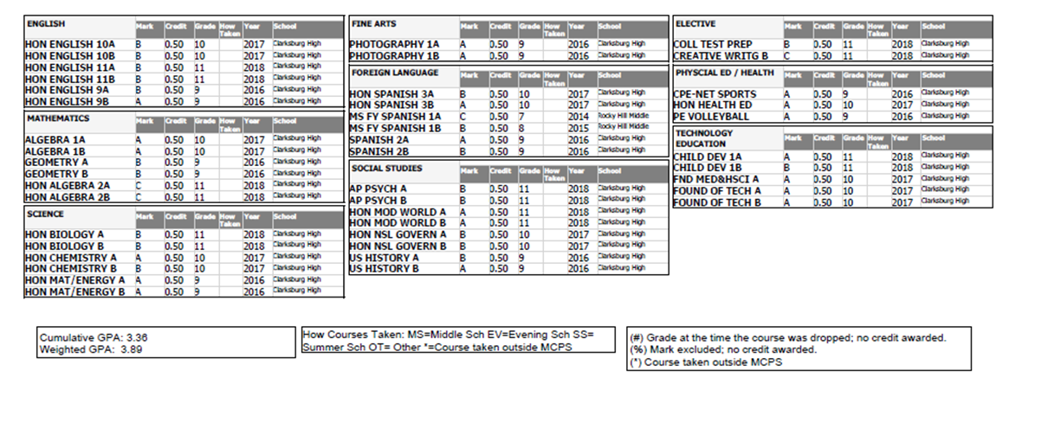
Transcript
1)What is the difference between an official and unofficial transcript?
2)Weighted vs. unweighted GPA?
3)What do colleges look for when reviewing a transcript?
4)Will colleges see my grades from senior year?

Slide 7
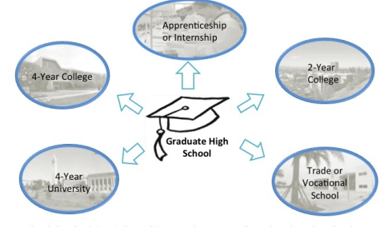
Different options after high school:
4-Year College
2-Year College
Military
Technical School
Apprenticeship
Work

Slide 8
Senior Packet
Due AT LEAST three weeks before your first deadline
Completed packet must be turned into the registrar, Mrs. Geisler
EVERYONE must complete a diploma order form

Slide 9
2-Year Application Components:
Application
Official Transcript
-submit transcript request form and diploma order
form in senior packet ONLY
Financial Aid

Slide 10
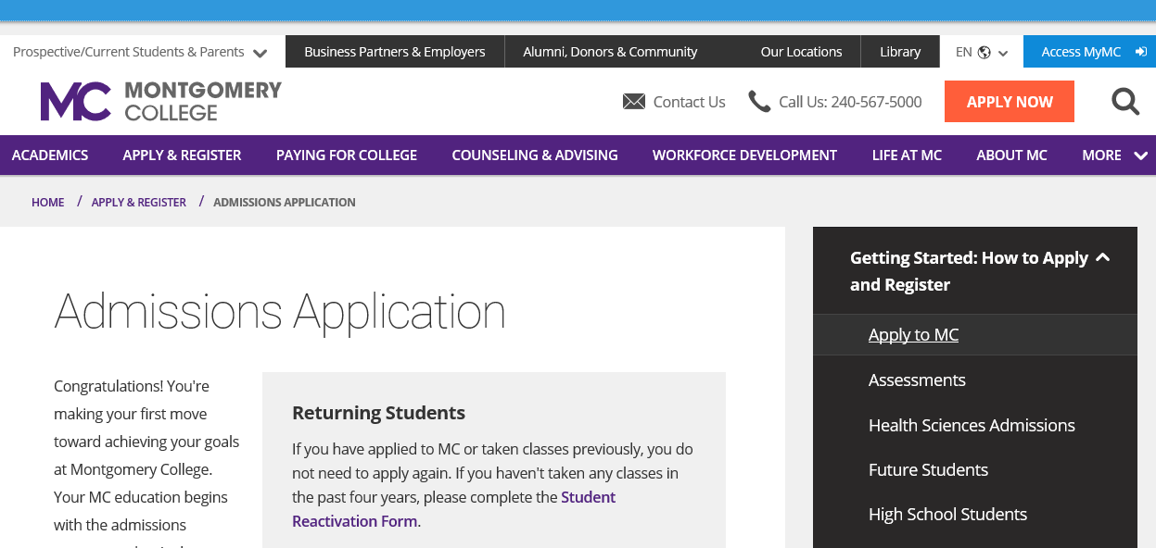
Application fee is waived beginning October 1st!

Slide 11
4 Year Application Components:
Application
Official Transcript
Official Test Scores-SAT / ACT Score Reports
Letters of Recommendation
Financial Aid
Personal Statement

Slide 12
How to request OFFICIAL transcripts:
1) Add colleges to your list on Naviance / Family Connection and link with Common App.
2) Complete your blue transcript request card.
3) Submit your transcript request card and all senior documents to Ms. Geisler, registrar, in the counseling department.
4) Submit all requests at least three weeks prior to application deadline.
*First 3 transcripts are free, the following 3 transcripts are $3, then any additional transcripts are $5

Slide 13
Testing
Types of College Admissions Tests:
SAT
ACT
TOEFL (Test of English as a Foreign Language)
Accuplacer (community college placement test)
How to send scores to colleges:
SAT and TOEFL: Request directly from College Board.
ACT: Request directly from ACT.
Accuplacer: Placement test completed at the community college that you plan to attend.

Slide 14
Letters of Recommendation
Teacher Recommendations:
- 1 or 2 Teachers: preferably academic subjects
- Request recommendation in person, THEN submit electronic request via NAVIANCE
- Ask early!
Counselor Recommendation:
- Counselors write recommendations for ALL seniors applying to college or trade schools!
- Counselor recommendations ARE DIFFERENT than teacher recommendations.
- Complete and submit brag sheets BEFORE or at the same time as transcript request.
- Transcript request card also serves as a request for a counselor letter.
- School profile is sent with counselor letter.

Slide 15
Financial Aid
Federal Application for Student Aid (FAFSA)
www.fafsa.ed.gov
- Submit after October 1st, 2019
Scholarships
Merit vs. Need Based
How do you find scholarships?
Meet with Ms. Sommerville in Career Center, attend workshops and evening meeting this Fall.
Check Career Center website regularly.
Use Naviance / Family Connection search.
Search online.
FAFSA Completion Workshop
Tuesday, October 15th
6:30-8:30

Slide 16
College /Career Center Supports
SAT / ACT / Accuplacer / ASVAB
College Majors, Essays, and Applications
Financial Aid and Scholarships
College Representatives and Guest Speakers
Naviance / Family Connection
Resume Writing
Career Planning
College Selection

Slide 17
CHS Writing Center
Ms. Stout and Ms. Bristor
Located in Lab 161
7:00am and lunch time daily or by appointment
(scheduled in Room 165)

Slide 18
What is Naviance / Family Connection?
Naviance / Family Connection is a FREE comprehensive, online program that assists students and parents with:
College and Career Planning
College application Process
Scholarship Searches
*Allows counselors and teachers to submit electronic transcripts and letters.

Slide 19
Allows CHS to electronically send…
Official Transcripts
Teacher Recommendations
Counselor Recommendations
…regardless of what application you use.

Slide 20
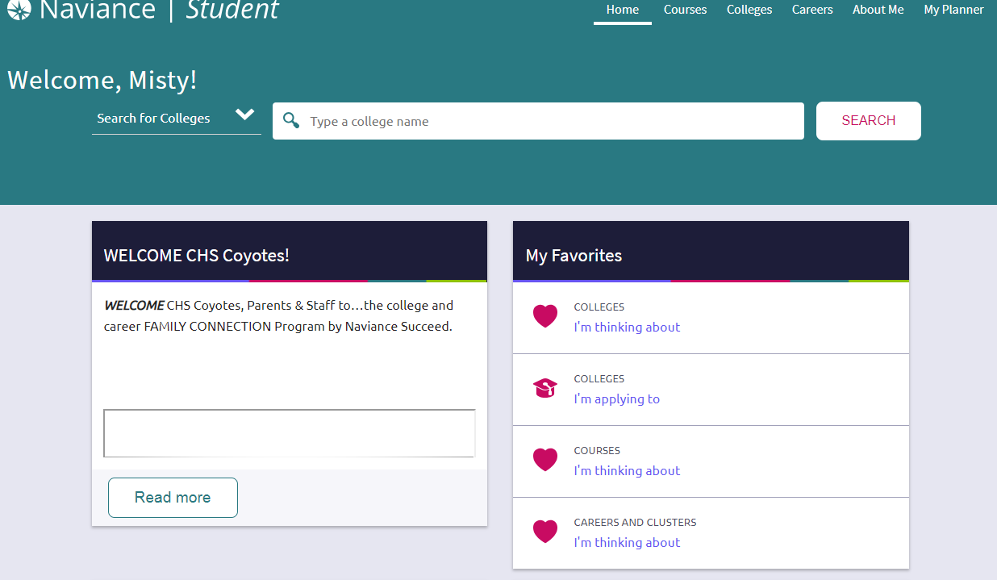
STEP 1: Log on to Naviance and click on “Colleges I’m Applying To.”

Slide 21
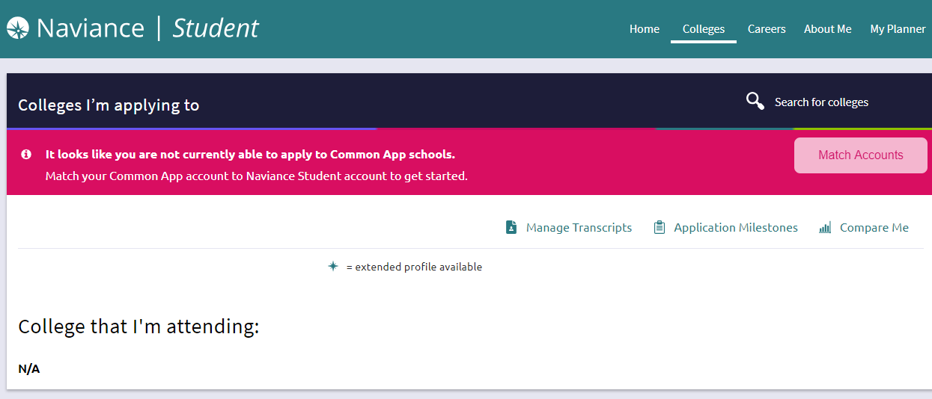
STEP 2: Click “Match Accounts” and follow prompts.

Slide 22
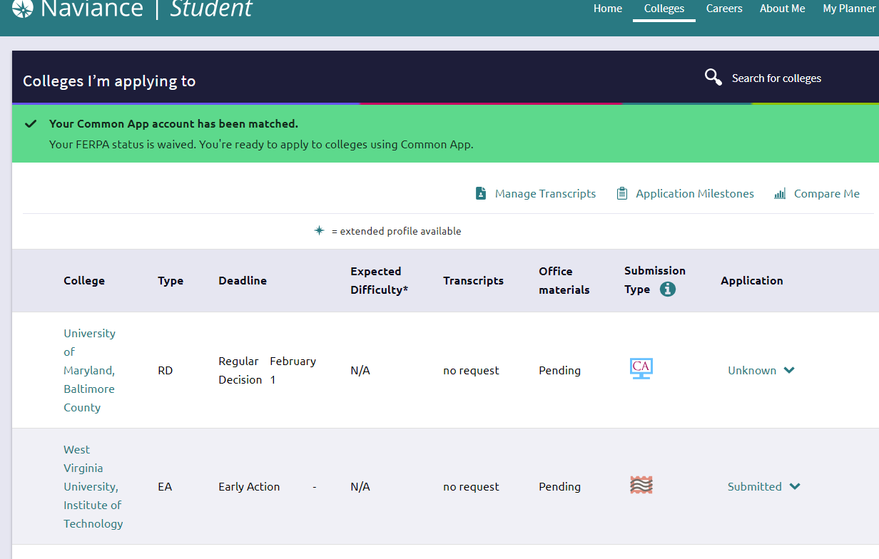
You will know you have matched successfully when the bar turns green.

Slide 23
Before submitting your blue transcript request card to Ms. Geisler, upload schools to your “College’s I’m Applying To” list by searching for college’s…

Slide 24
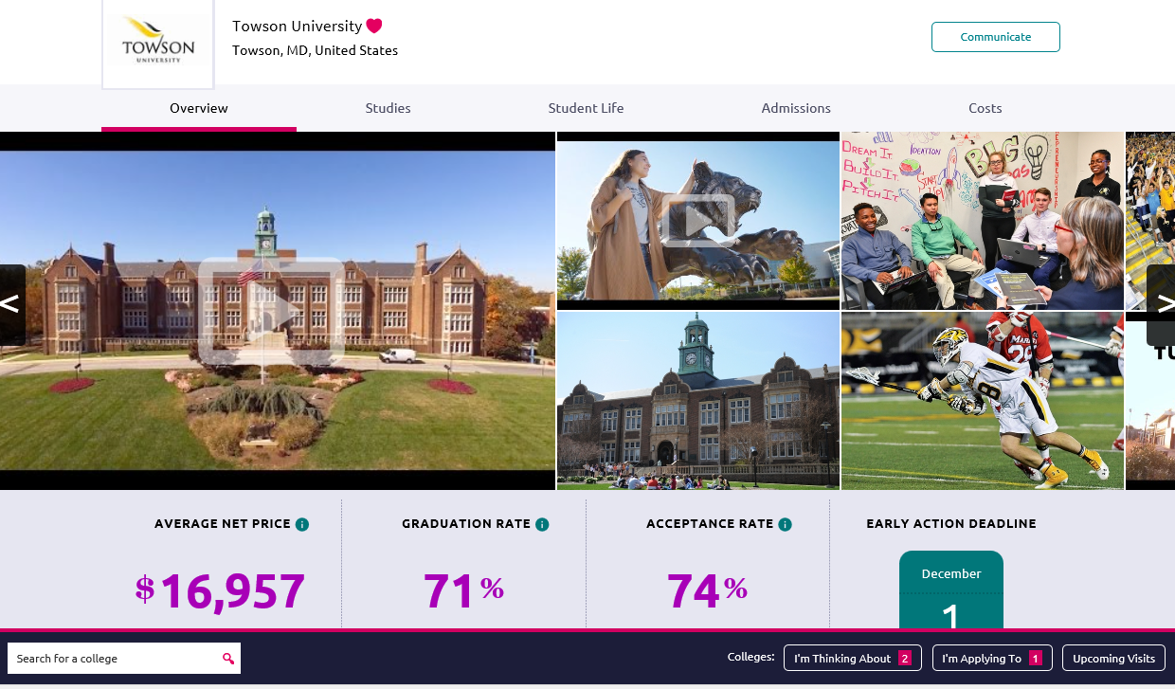
…and clicking “I’m Applying To” at the bottom of your school’s page.

Slide 25
My College Applications
*Common Application
What is it?
Do I have to apply via Common App if the school accepts it?
When can I begin completing it?
How does information get from the Common App to my colleges?
How do you link Common App to Naviance / Family Connection?
*Coalition Application
See list of participating schools in senior packet or at:
coalitionforcollegeaccess.org.
*School’s Application
Available on each college’s website.

Slide 26
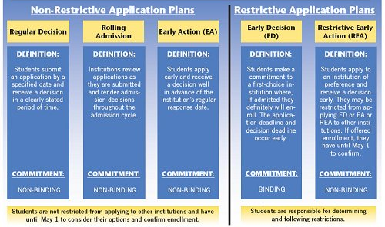
Application Deadlines
Notes:
PRIORITY
Students are given priority consideration for admission and financial aid
EARLY DECISION
If you apply for early decision and are accepted to the college…. YOU MUST ATTEND THIS SCHOOL. Applying for early decision looks better to the school because you are showing much more interest.
EARLY ACTION
Students receive an early response to their application but don't have to fully commit to the school if they are accepted.
ROLLING
Applications are considered in the order they are received.

Slide 27
What is the difference between types of application deadlines?

Slide 28
Questions?

