Slide 1
Curriculum 2.0 Marking Period Information

Slide 2
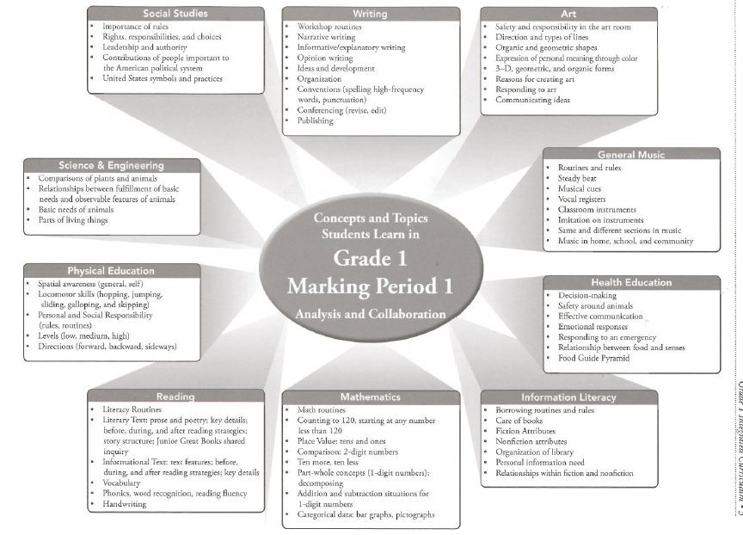

Slide 3
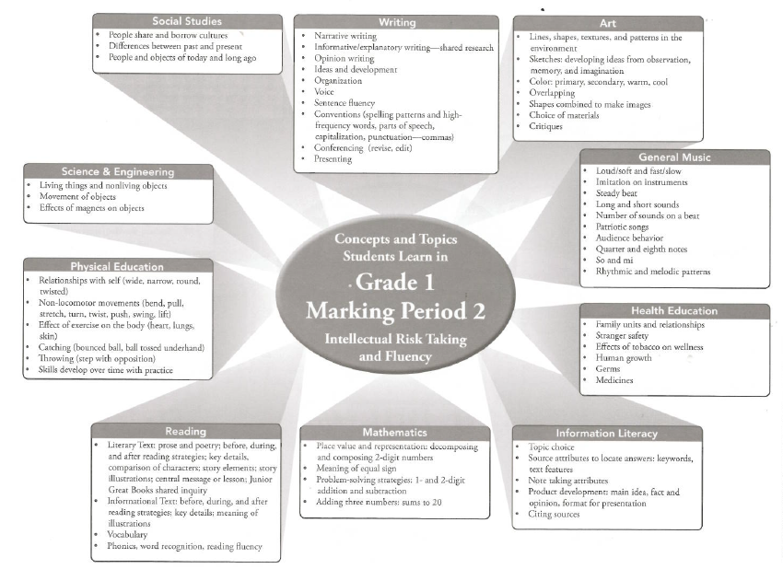

Slide 4
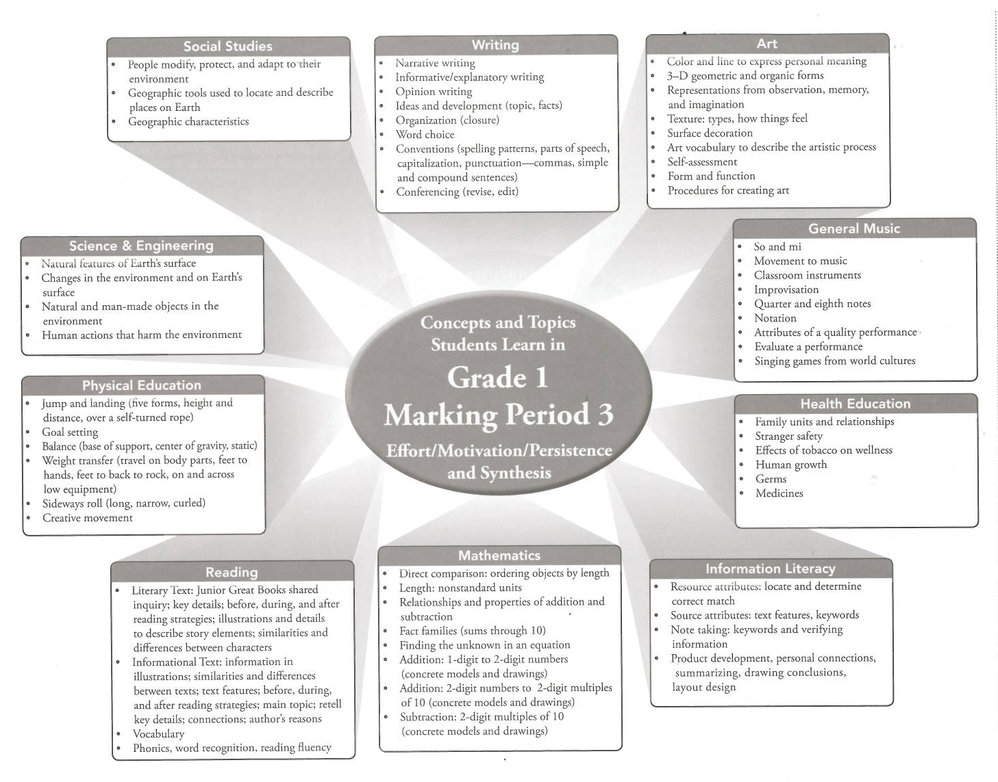

Slide 5
